Slide 1
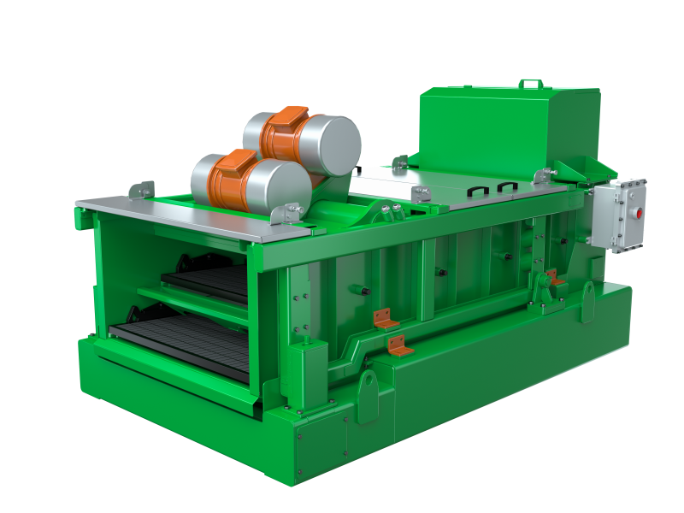
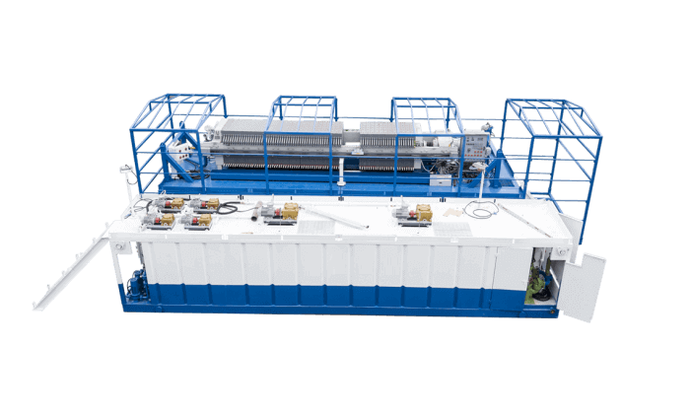
Chengdu West Petroleum Equipment Co., Ltd.
Booth: W1234, Hall W1

